Slide 1
Defect Detection in Fabric
Team: -Knight Riders
Members:-
Satyam Kumar (IITJ, BSBE)
Vishnu Kumar (IITJ, BSBE)
Rishav Kumar (IITJ, MECH)

Slide 2
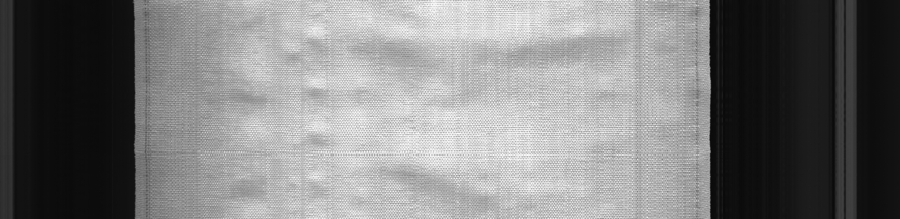
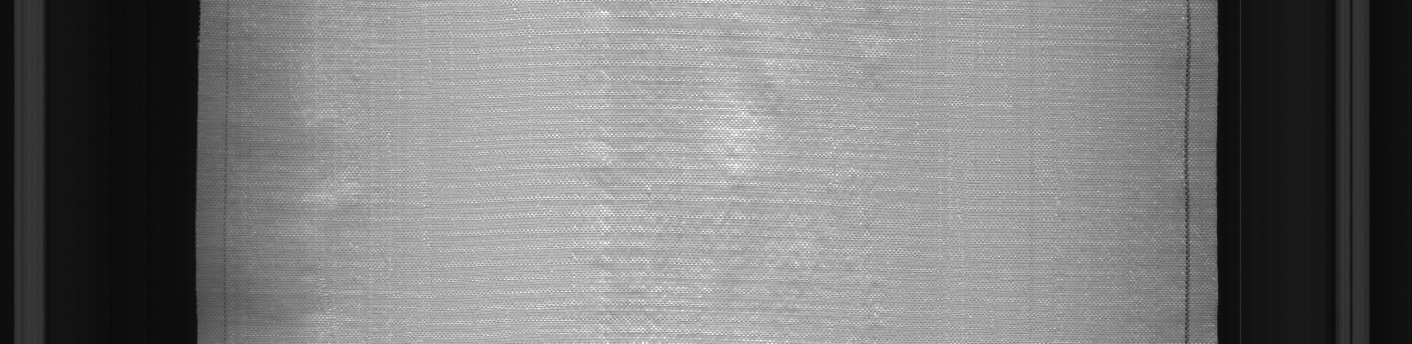
Task 1 : - Image classification
Bad Image
I worked on TensorFlow environment. And used libraries like OpenCV, pandas, matplotlib, NumPy
Resized input image in (224 X 224 X 3).
Used MobileNetV2 architecture for image classification
Used image augmentation technique
Good Image

Slide 3
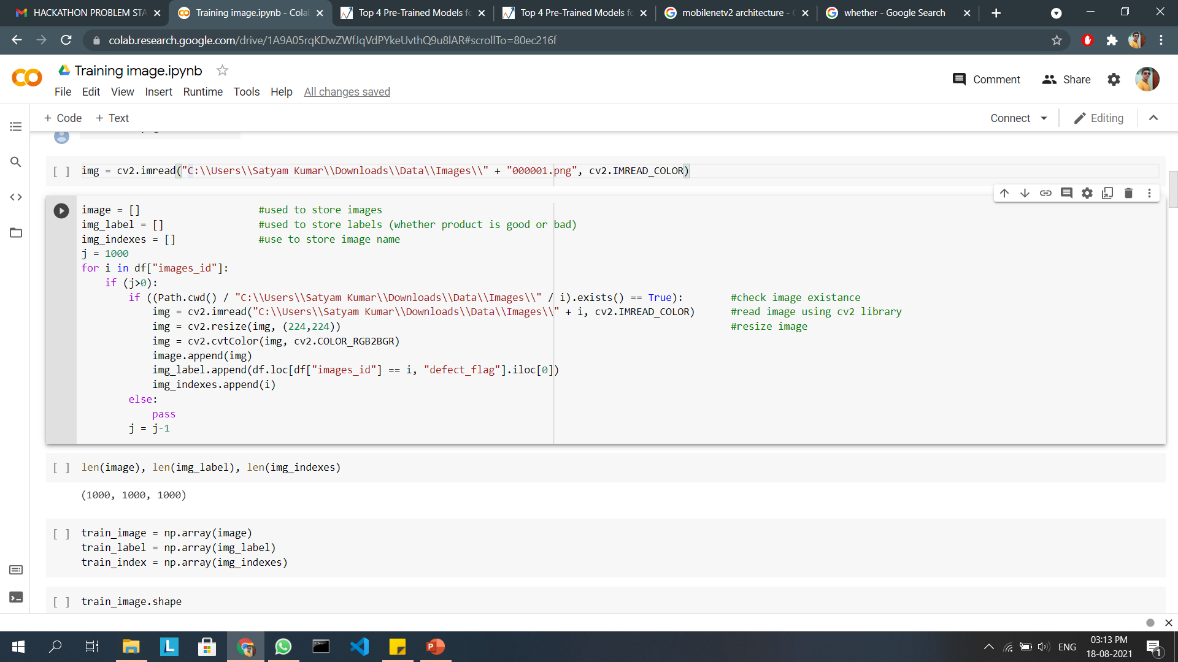
A.) Pre-processing of Data
Convert all 3 - list (mentioned in fig below) into NumPy array
Scale image array by dividing it with maximum value of pixels i.e., 255.0
Used PathLib library to check whether image is available or not which is mentioned in csv file
Resize image (224, 224) so that I can use pre trained model i.e., MobileNetV2

Slide 4
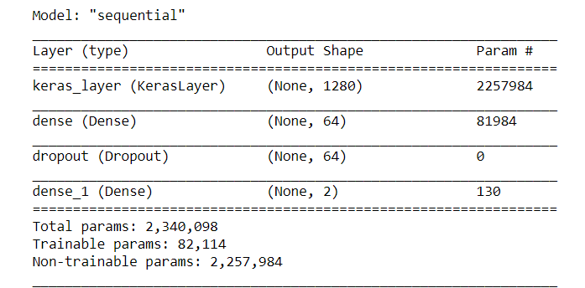
B.) Model training
Summary of my model
Used pre-trained weights and mark false for trainable parameter so that weights must not change
Now added 2 dense layer and a dropout of 0.2so that my model will avoid overfitting
Used SparseCategoricalCrossentropy loss and Adam optimizer
Used 50 epochs for training and a batch size of 50
P.S. If used higher epoch then accuracy would be better but due to limiting condition of my hardware I am not able to do so

Slide 5
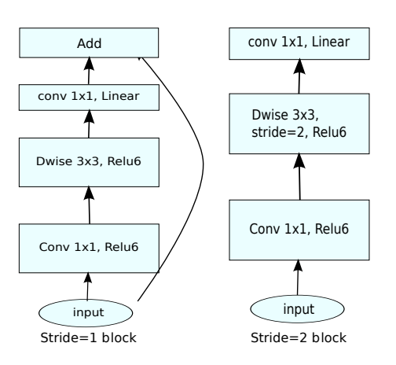
C.) Making of csv
MobileNetV2 (Model overview)
Achieve a testing accuracy of 91% and validation accuracy of 84%
Predict the label on testing data from our model and store it in a data frame
Use argmax to extract the most important feature from prediction value
Use concatenation on image name and its corresponding label to make data frame same as given in sample submission

Slide 6
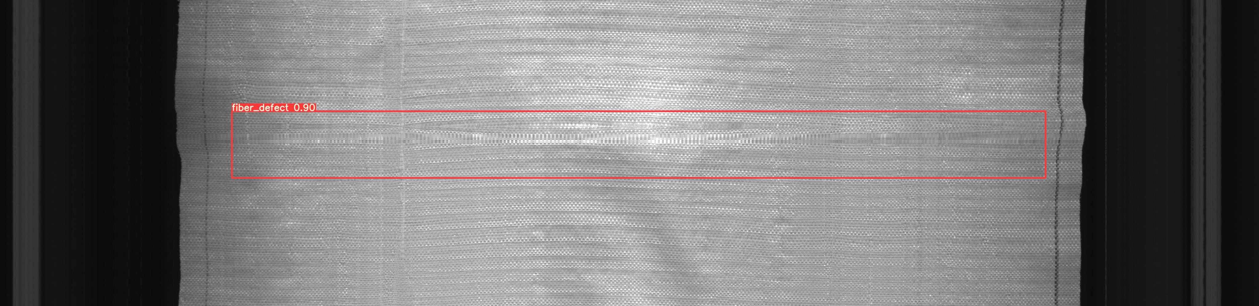
Task 2: - Making of bounding box
I worked on TensorFlow environment. And used libraries like OpenCV, pandas, matplotlib, NumPy
Resized input image in (224 X 224 X 3)
Used VGG 16 and MobileNetV2 and found that 2nd model give better result on testing and validation set
P.S. Reshaping of image will not affect position of bounding boxes because X,Y,W,H coordinates

Slide 7

Vgg-16 model

Slide 8
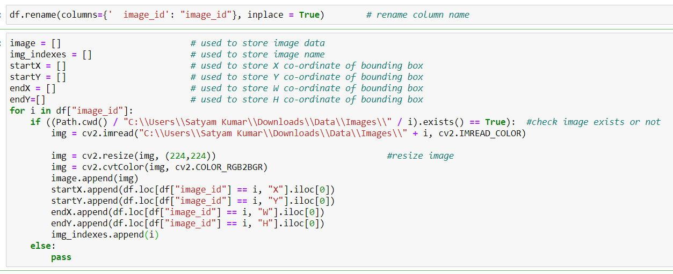
A.) Pre-processing of Data
Used same pre-processing technique as used in Task -1
This task is only for bad images so I select all the images whose label is 1
One of the column name is “ index_id”. So due to problem in calling name I changed it to “index_id”

Slide 9
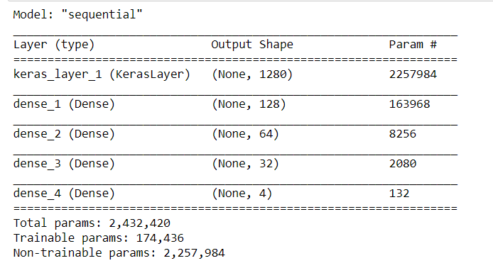
B.) Model training
Summary of my model
Used pre-trained weight with additional dense layer. Our final dense layer have 4 perceptron because we have to predict 4 values (X, Y, W, H)
Used Adam optimizer and mse (mean square error) loss
Trained on 40 epochs and on 500 image dataset

Slide 10
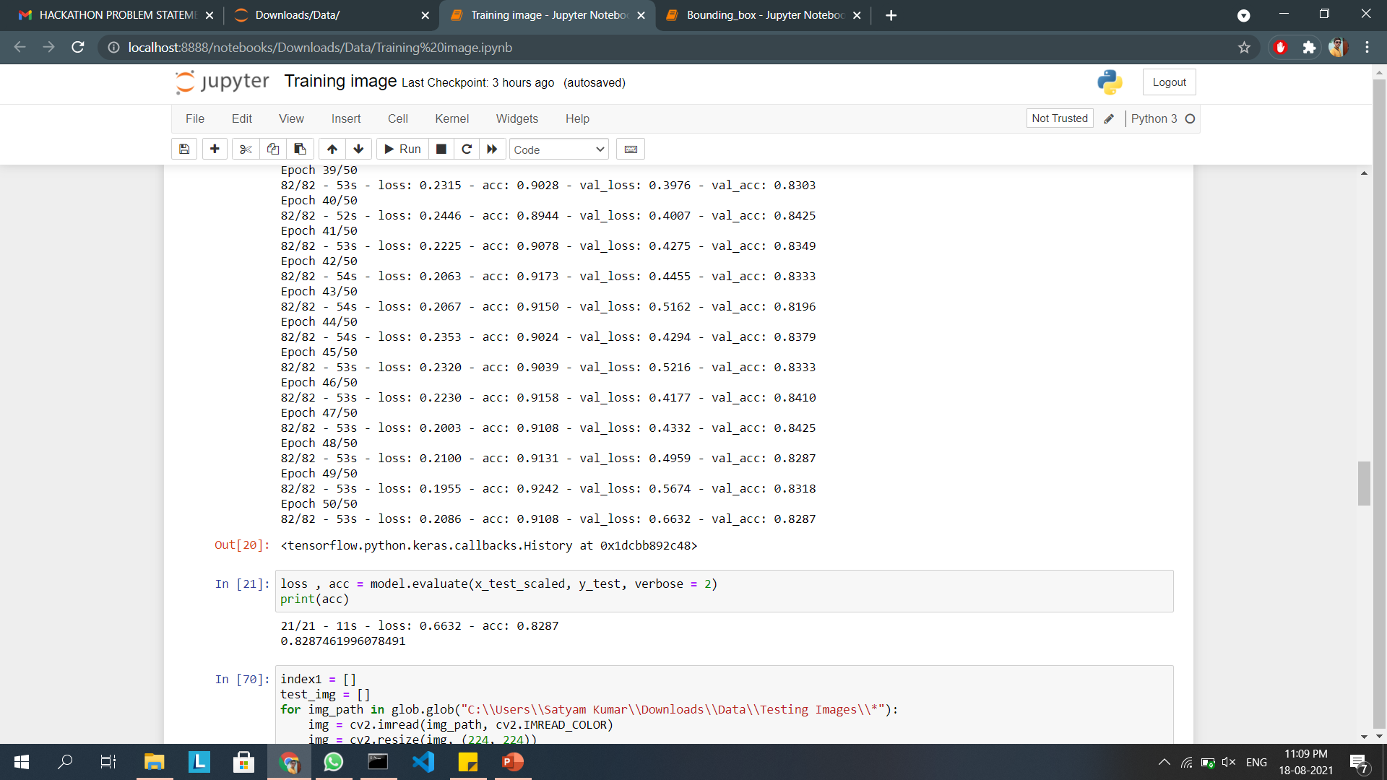
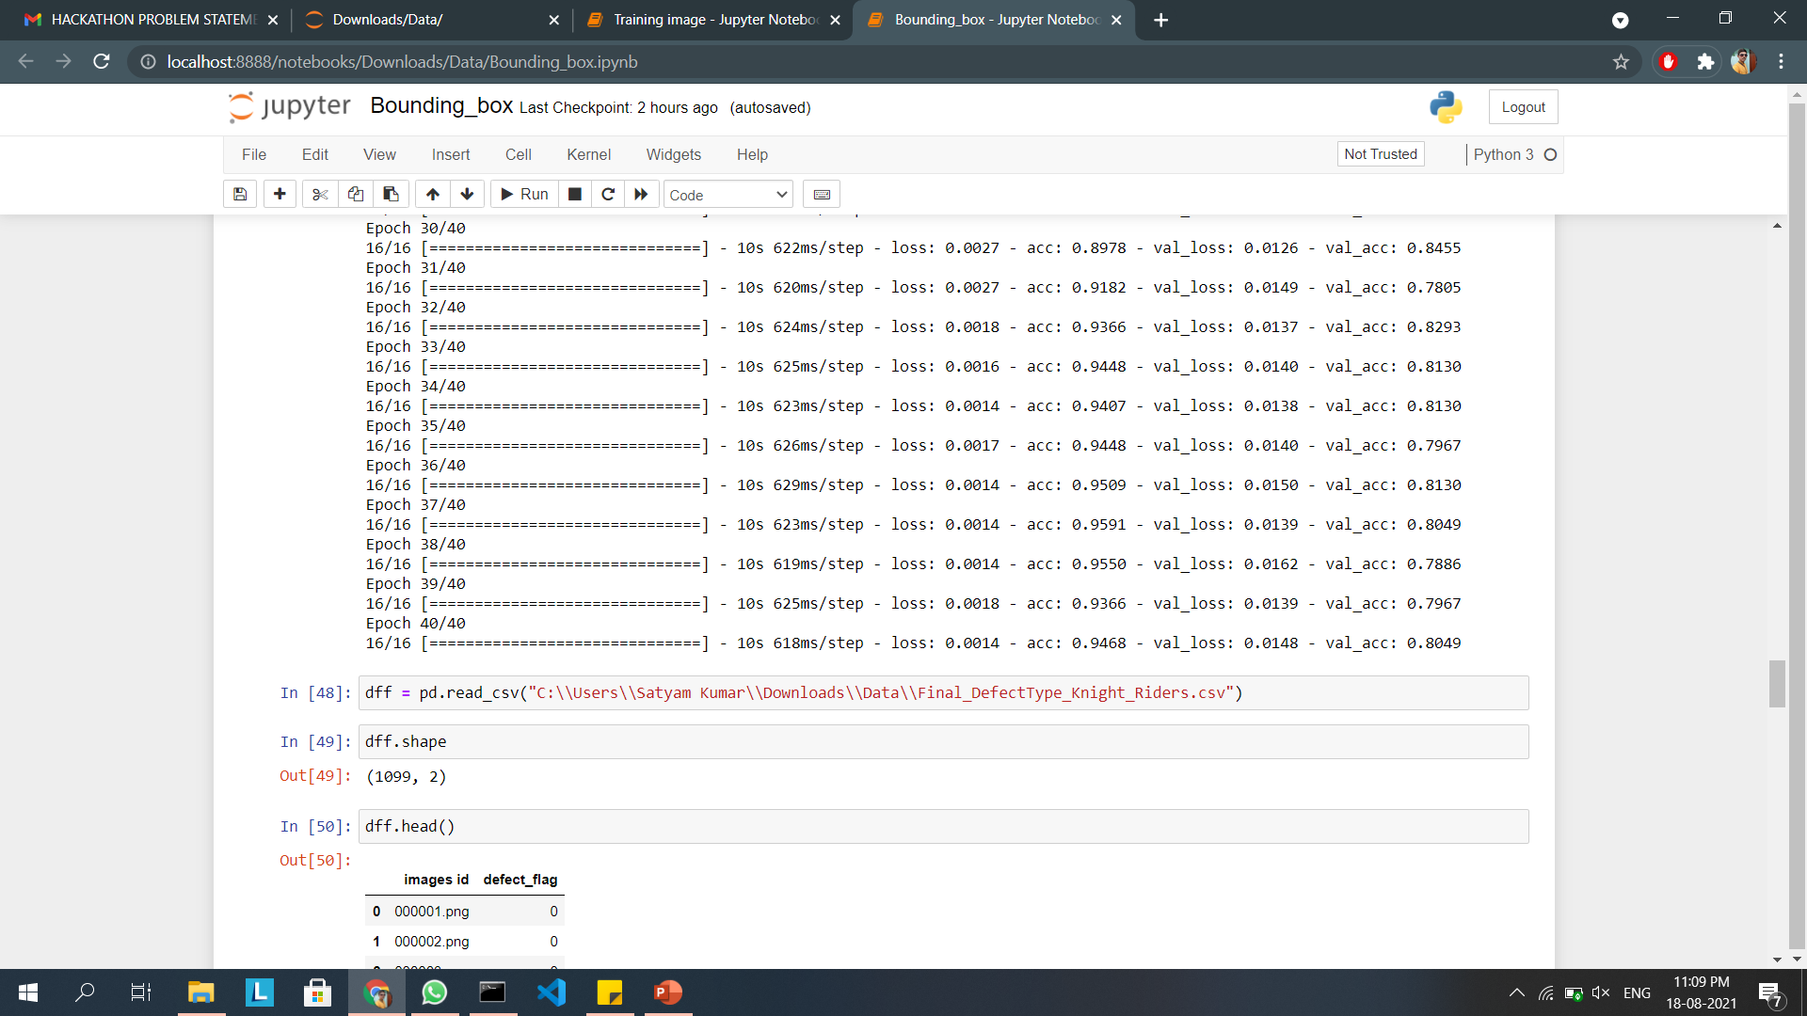
Accuracy
Accuracy on Task 1
Achieved an accuracy of 91.8% on testing data and 83% on validation data in Task 1
Achieved an accuracy of 80% on testing data and 81% on validation data in Task 2 using Vgg 16 model and with few dense layer
Achieved an accuracy of 91% on testing data and 82% on validation data in Task 2 using MobileNetV2 and with few dense layer
Accuracy on Task 2

Slide 11

Thank you
Open CV

